Slide 1

WELCOME
To Our Project Presentation
history
history
history
history
Mentor
follow
Teams
services
teams
about
timeline
about
follow
about
services
teams
about
about
timeline
about
about
about
Experience
Introduction
RTM
Contents
Elicitation Techniques
Requirement Analysis
Requirements
Diagnostic Center client co-ordination system

Slide 2
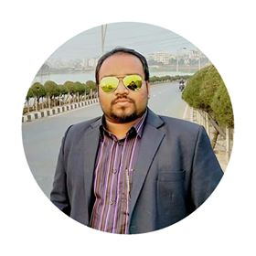

WELCOME
To Our Project Presentation
Teams
Mentor
history
history
history
history
Elicitation Techniques
follow
Introduction
services
teams
about
timeline
about
follow
about
services
teams
timeline
about
Contents
about
about
about
about
about
Requirements
RTM
Experience
Requirement Analysis
Md. Iftekhar Alam Efat
Flappy Bird
Lecturer
Institute Of Information Technology
Noakhali Science And Technology University

Slide 3
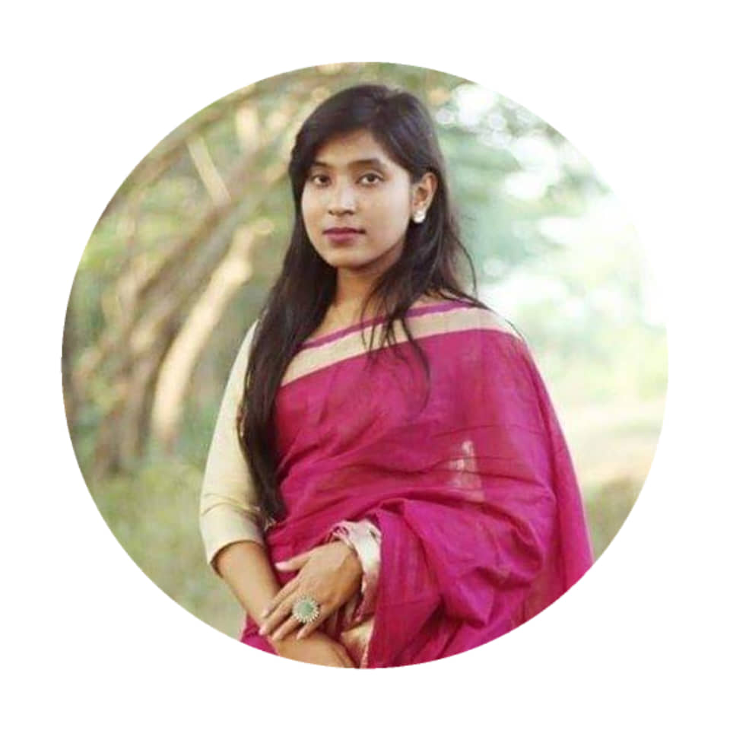
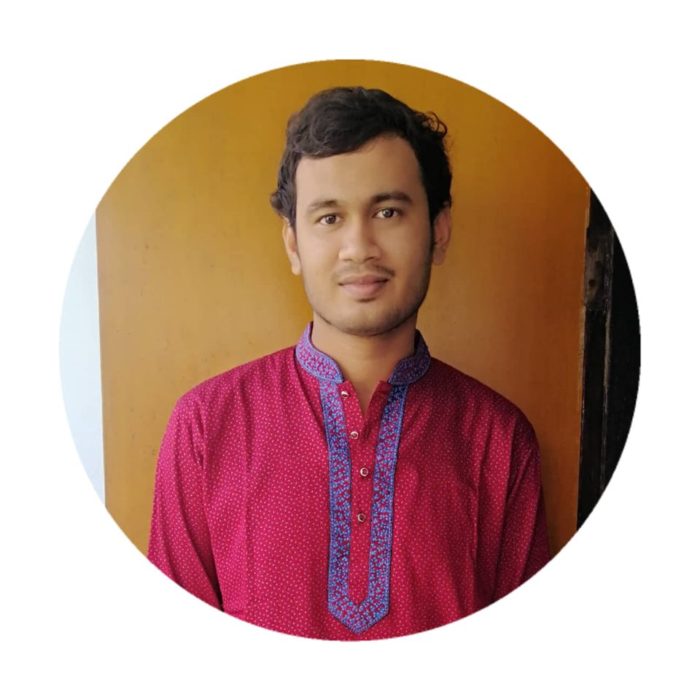
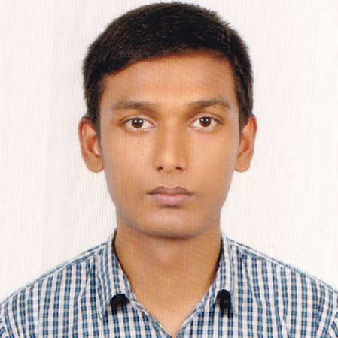
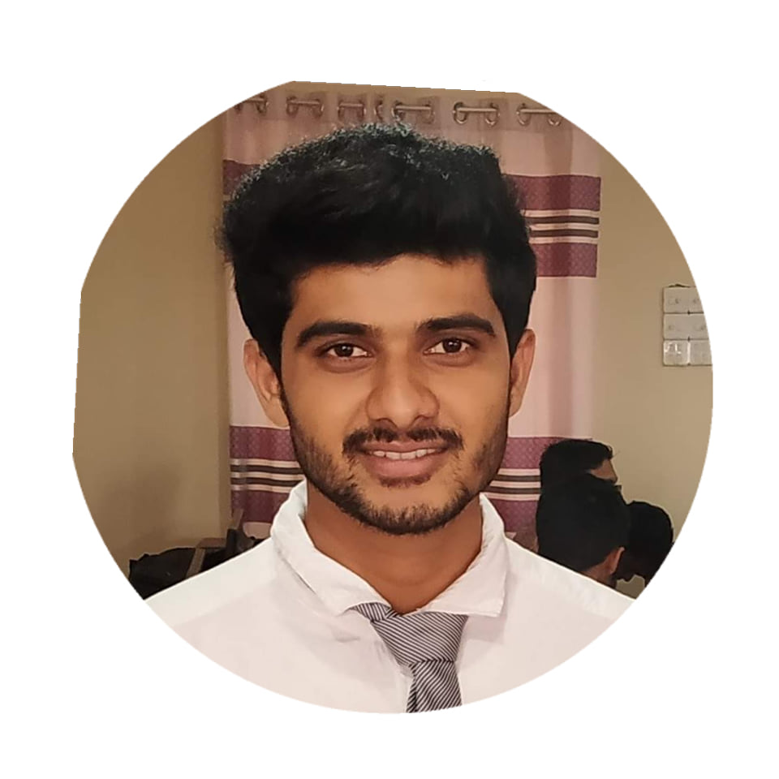
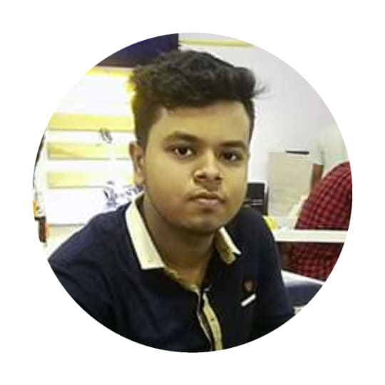
01
02
WELCOME
Moonmoon Das
BKH1825027F
Saifur Rahman
ASH1825031M
To Our Project Presentation
Elicitation Techniques
history
history
history
history
follow
services
teams
about
timeline
about
follow
about
services
teams
RTM
about
timeline
about
Mentor
Experience
about
about
about
about
Requirements
Contents
Team Members
Requirement Analysis
Introduction
03
04
05
Flappy Bird
Md. Mahabub Alam
ASH1825003M
Nadim Bhuiyan
ASH1825034M
Al Shahriar Priyo
ASH1825020M

Slide 4
Introduction
WELCOME
Proposed Requirements
Elicitation Techniques
To Our Project Presentation
Collected Requirements
history
Teams
history
history
history
Elicitation Techniques
follow
services
teams
about
timeline
about
follow
about
Mentor
services
teams
about
about
timeline
about
about
about
about
Introduction
Contents
RTM
Experience
Requirements
Experience with Stakeholders
Requirement Analysis
Collected Requirements
Flappy Bird
Requirement Analysis
RTM

Slide 5
WELCOME
Diagnosis centers need to maintain good relations with their clients. There is always a database of clients maintained in every diagnostics center.
The database includes client contact details as well as his tests done. It includes data like contact numbers, name, address, email etc.
Clients may conduct various tests at the diagnostic center including blood test, urine test as well as cholesterol, liver and kidney tests.
The system allows admin to store and update patient data for existing and new patients.
To Our Project Presentation
Proposed Requirements
history
Teams
history
history
history
follow
Mentor
services
teams
about
timeline
about
follow
about
services
teams
about
about
timeline
about
about
about
about
Contents
RTM
Experience
Introduction
Requirement Analysis
Elicitation Techniques
Flappy Bird

Slide 6
WELCOME
We divided our Requirements based on five stakeholder are as follows:
Sign up / Log in (Functional Requirement)
Choosing doctors from specific categories
Set appointment
Updating appointment
Choosing doctor from nearest health centre
History check
Contacting with the clinic hotline
To Our Project Presentation
Requirement Analysis
history
Proposed Requirements
Teams
history
history
history
follow
services
teams
about
timeline
about
follow
about
services
teams
about
about
timeline
about
Mentor
about
Contents
about
about
Introduction
Elicitation Techniques
RTM
Experience
Patient
Collected Requirements
Flappy Bird

Slide 7
WELCOME
Add Registered clinic with payment
Add Doctors
Add medicine centres
Check appointment
Check previous test report and medicine
Provide new prescription with patient ID
Clinic
To Our Project Presentation
history
Teams
history
history
history
follow
services
teams
about
timeline
about
follow
about
services
teams
about
about
timeline
about
Mentor
about
Contents
RTM
about
about
Introduction
Experience
Collected Requirements
Requirement Analysis
Elicitation Techniques
Flappy Bird
Doctors

Slide 8
Check doctor's prescription with patient ID and doctors ID
Entre new test report information in database
Provide discount for old patient
Provide Print copy of test report (Non-Functional)
Check prescription with patient and doctors ID
Send confirmation message to patient for after confirm
appointment
Giving 10% discount for old patient
Add printer to print prescription
WELCOME
Lab Reporter
To Our Project Presentation
history
Medicine Center
Proposed Requirements
Teams
history
history
history
Experience
follow
services
teams
about
timeline
about
follow
about
services
teams
about
about
timeline
about
Mentor
about
Contents
RTM
about
about
Introduction
Elicitation Techniques
Requirements Analysis
Flappy Bird
System Requirement

Slide 9
WELCOME
Interviews:
Objective of conducting an interview is to understand the customer’s expectations from the software.
Interviews maybe be open ended or structured.
In open ended interviews there is no pre-set agenda. Context free questions may be asked to understand the problem.
In structured interview, agenda of fairly open questions is prepared. Sometimes a proper questionnaire is designed for the interview.
Proposed Requirements
To Our Project Presentation
history
Requirement Analysis
history
Teams
history
history
follow
Elicitation Techniques
services
teams
about
timeline
about
follow
about
services
teams
RTM
about
timeline
about
Contents
about
about
Introduction
Mentor
about
about
Collected Requirements
Flappy Bird

Slide 10
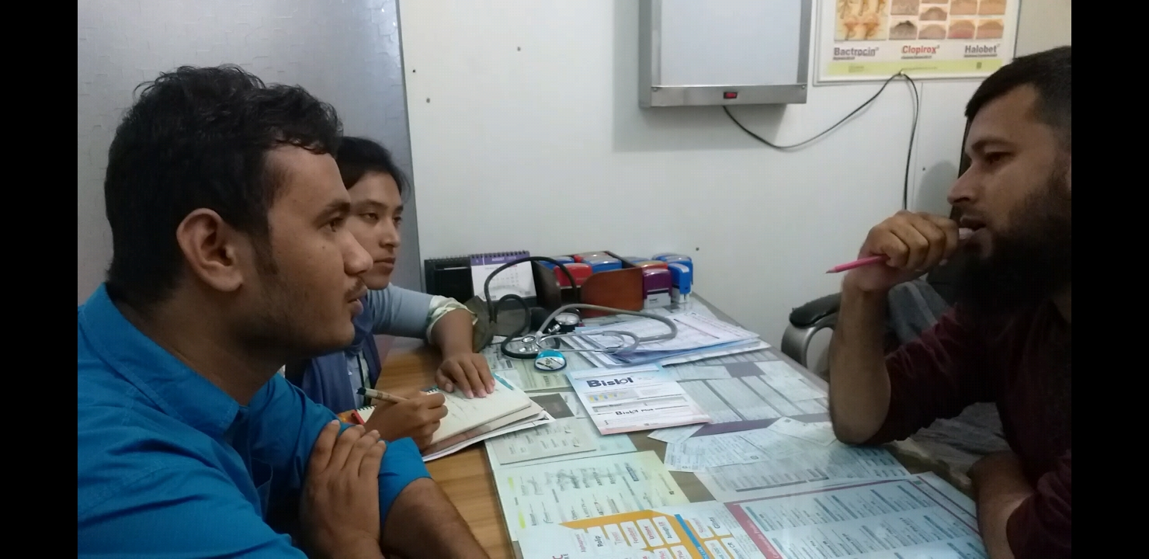
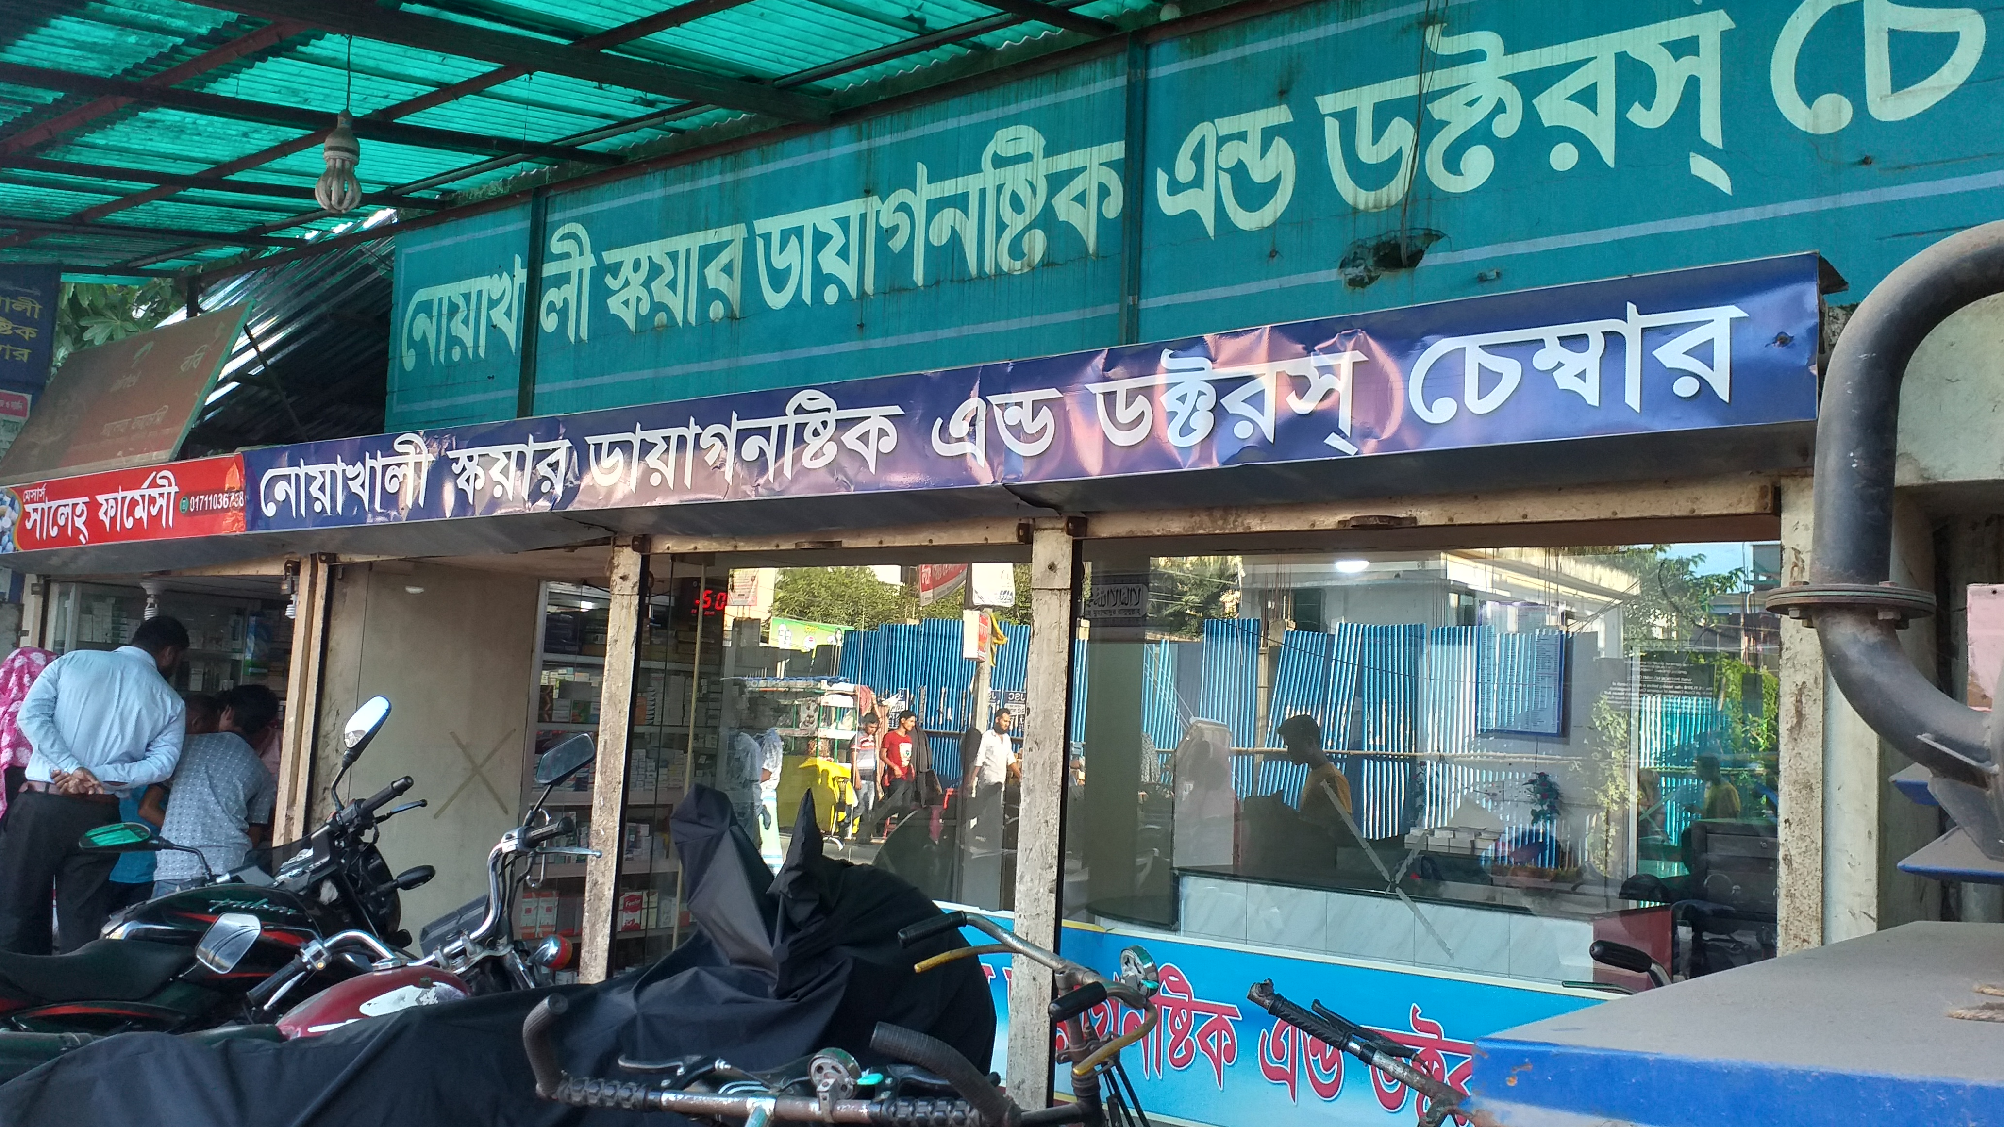
WELCOME
Proposed Requirements
To Our Project Presentation
history
Requirement Analysis
history
Teams
history
history
follow
Elicitation Techniques
services
teams
about
timeline
about
follow
about
services
teams
RTM
about
timeline
about
Contents
about
about
Introduction
Mentor
about
about
Collected Requirements
Flappy Bird

Slide 11
We were following structured interview. We asked them some specific questions. A proper questionnaire is designed for the interview.
Questions:
WELCOME
How many client are handled in daily?
Are they use any type of database?
How many doctors are includes in their system?
In appointment time, are they receive any money?
Any medicine center are including in their system?
Are they gives discount for second time client?
Are they accept any emergency patient?
Which types of problem they are face?
Proposed Requirements
To Our Project Presentation
history
history
history
Teams
history
follow
Elicitation Techniques
services
teams
about
timeline
about
follow
about
services
teams
about
timeline
about
Contents
about
about
Introduction
Mentor
about
about
Experience
RTM
Collected Requirements
Flappy Bird

Slide 12
WELCOME
Observation:
Every observation must be guided by clearly stated objectives. The analyst should know what data is to be collected, how observation will be done, when and where to observe, how the data will be collected and what the data will be used for after analysis. In observation of elicitation techniques we observe the diagnostic center management system. We observe:
How they manage the client and client information.
How they manage doctor information.
How they manage the doctor appointment system.
How they mange their database.
How they manage their pathology department.
How they manage their system.
Proposed Requirements
To Our Project Presentation
history
history
history
Teams
history
follow
Elicitation Techniques
services
teams
about
timeline
about
follow
about
services
teams
about
timeline
about
Contents
about
about
Introduction
Mentor
RTM
about
about
Experience
Collected Requirements
Flappy Bird

Slide 13
System interface analysis:
We saw the system interface in a diagnostic center. Here we saw –
They use a database system to manage their client
When the patient arrives in the reception to set their appointment then they will entry the client information
They take full doctor fees from the patient in the appointment time
They don’t use any patient ID to store patient information
They don’t use any hotline .
They don’t receive any emergency patient
WELCOME
Proposed Requirements
To Our Project Presentation
history
Elicitation Techniques
history
history
Teams
history
follow
services
teams
about
timeline
about
follow
about
services
teams
about
timeline
about
Contents
about
about
Introduction
Mentor
about
about
Collected Requirements
Experience
RTM
Flappy Bird

Slide 14
We tried to collect requirements according to our proposed requirements.
Happily, we have been able to collect our all propose requirement without some requirements such as:
Updating appointment
Contacting with the clinic hotline
Choosing doctor from nearest health centre
Check prescription with patient and doctors ID in medicine center [we don’t talk with medicine center for some restrictions]
WELCOME
To Our Project Presentation
Collected Requirements
Teams
history
Elicitation Techniques
history
history
history
follow
Requirements
Mentor
services
teams
about
timeline
about
follow
about
services
teams
about
about
timeline
about
about
RTM
about
about
Contents
Requirement Analysis
Introduction
Experience
Flappy Bird

Slide 15
WELCOME
We also go to the various hospital for collecting requirements. We gather some new experience. Also, We are very pleased to talk to the management of various hospitals and we face some difficulties are follows :
They cannot understand us about our project.
Do not want to give us time.
After a long time waiting, they do not want to talk us with management.
They didn't allow us to meet the management even after we took the Varsity ID card and permission paper.
Even after talking to some hospital management, they were not allowed to see how their system operates.
To Our Project Presentation
Requirements
Elicitation Techniques
history
Collected Requirements
Teams
history
history
history
history
follow
Mentor
services
teams
about
timeline
about
follow
about
services
teams
about
about
timeline
about
about
about
Experience
about
about
CONTENTS
Introduction
Flappy Bird

Slide 16
WELCOME
Use Case Diagram
Use Case Description
Activity Diagram
To Our Project Presentation
Requirement Analysis
Requirements
Experience
Teams
history
Elicitation Techniques
history
history
history
follow
Mentor
services
teams
about
timeline
about
follow
about
services
teams
RTM
timeline
about
about
Introduction
about
Contents
about
about
about
about
Flappy Bird

Slide 17
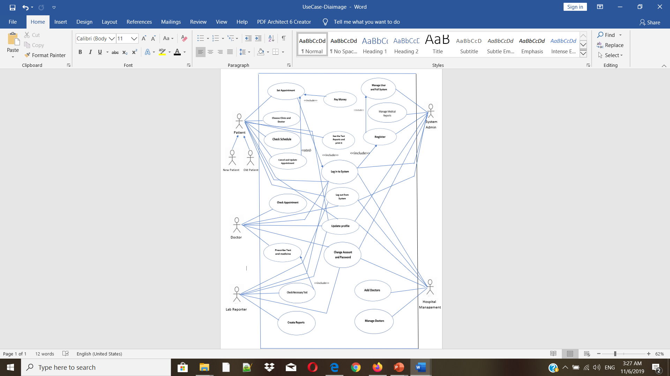
Use Case Diagram
WELCOME
To Our Project Presentation
Requirement Analysis
Requirements
Experience
Teams
history
Elicitation Techniques
history
history
history
Mentor
RTM
follow
services
teams
about
timeline
about
follow
about
services
teams
about
timeline
about
Introduction
about
about
Contents
about
about
Flappy Bird

Slide 18
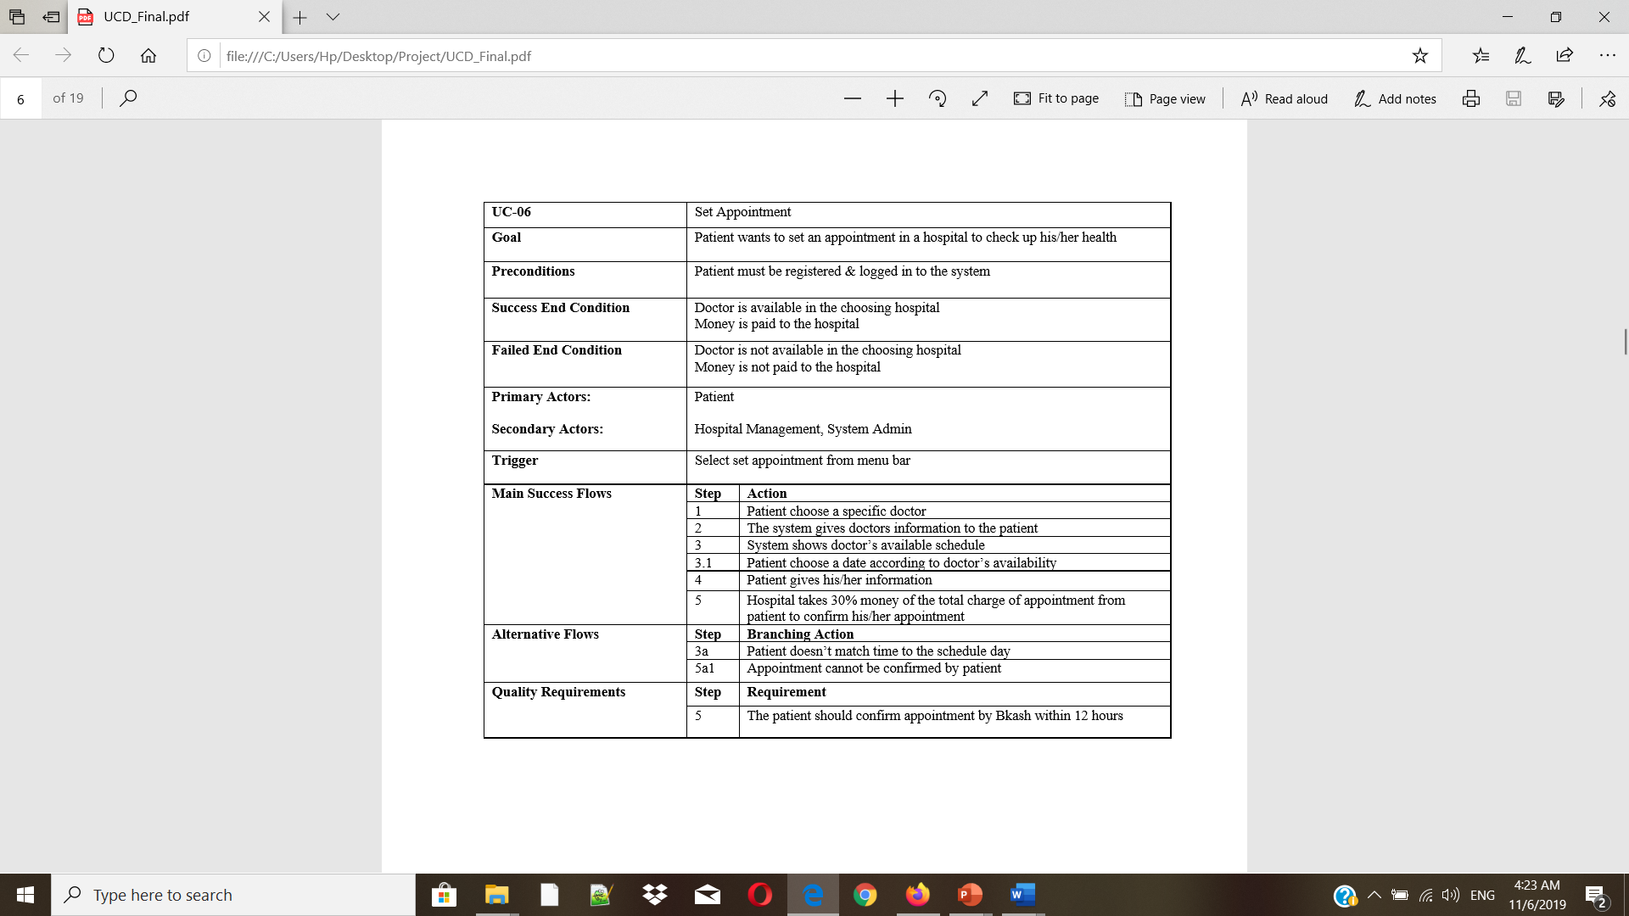
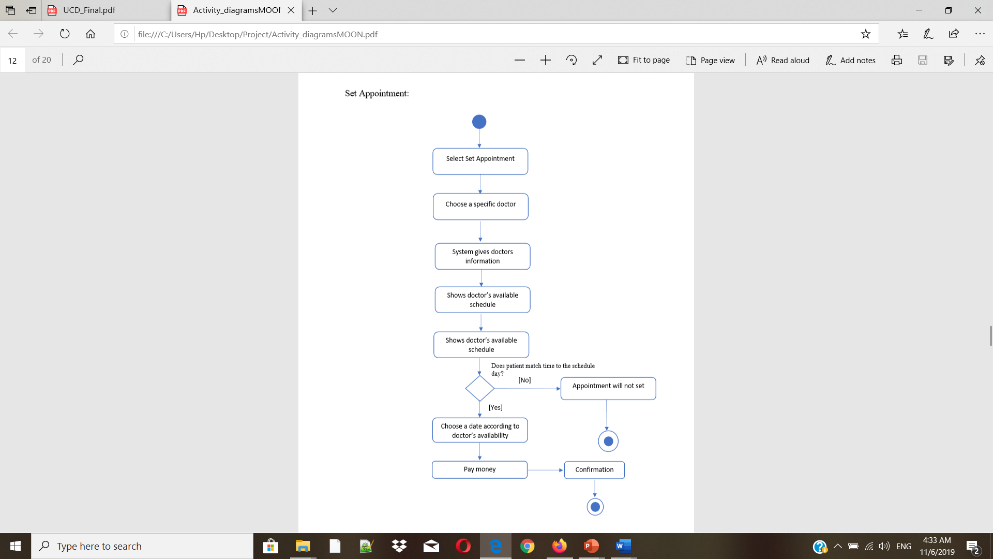
Use Case Description and Activity Diagram
WELCOME
To Our Project Presentation
Requirement Analysis
Requirements
Experience
Teams
history
Elicitation Techniques
history
history
history
follow
Mentor
services
teams
RTM
timeline
about
about
follow
about
services
teams
about
timeline
about
Introduction
about
about
Contents
about
about
Flappy Bird

Slide 19
Use Case Description
WELCOME
To Our Project Presentation
Requirement Analysis
Requirements
Experience
Teams
history
Elicitation Techniques
history
history
history
follow
Mentor
services
teams
RTM
timeline
about
about
follow
about
services
teams
about
timeline
about
Introduction
about
about
Contents
about
about
Flappy Bird

Slide 20
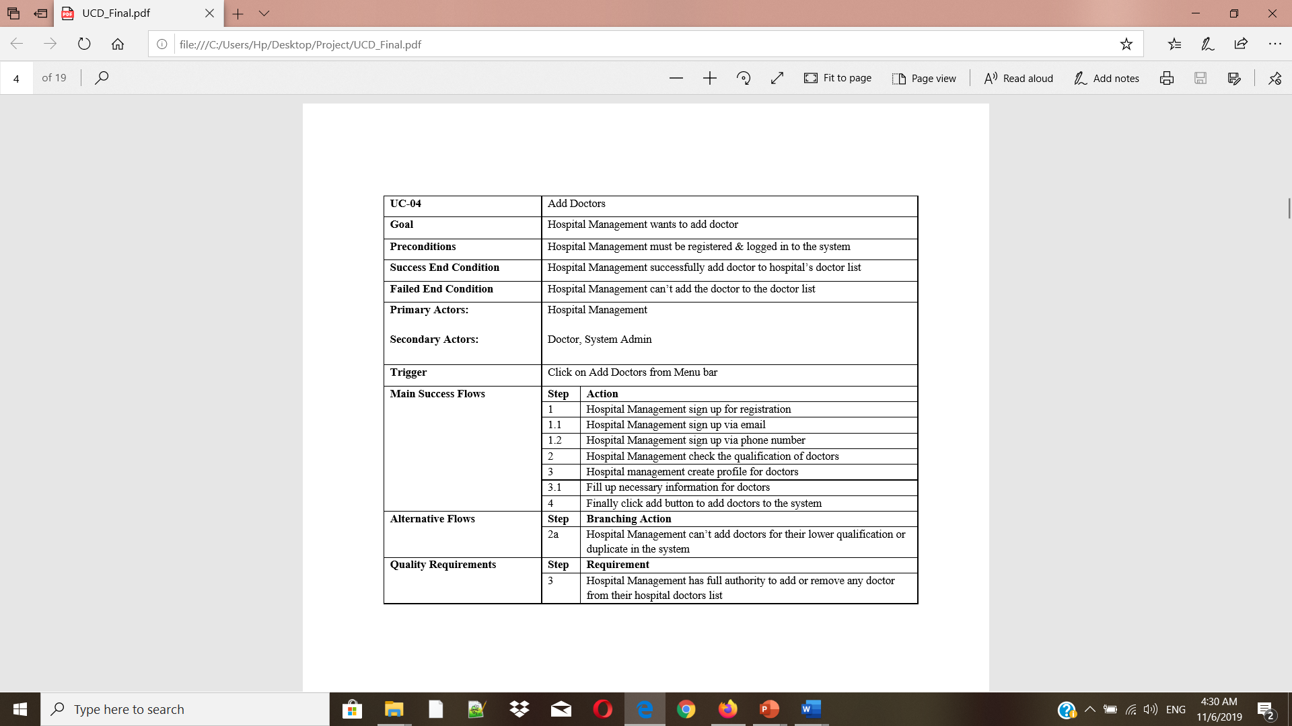
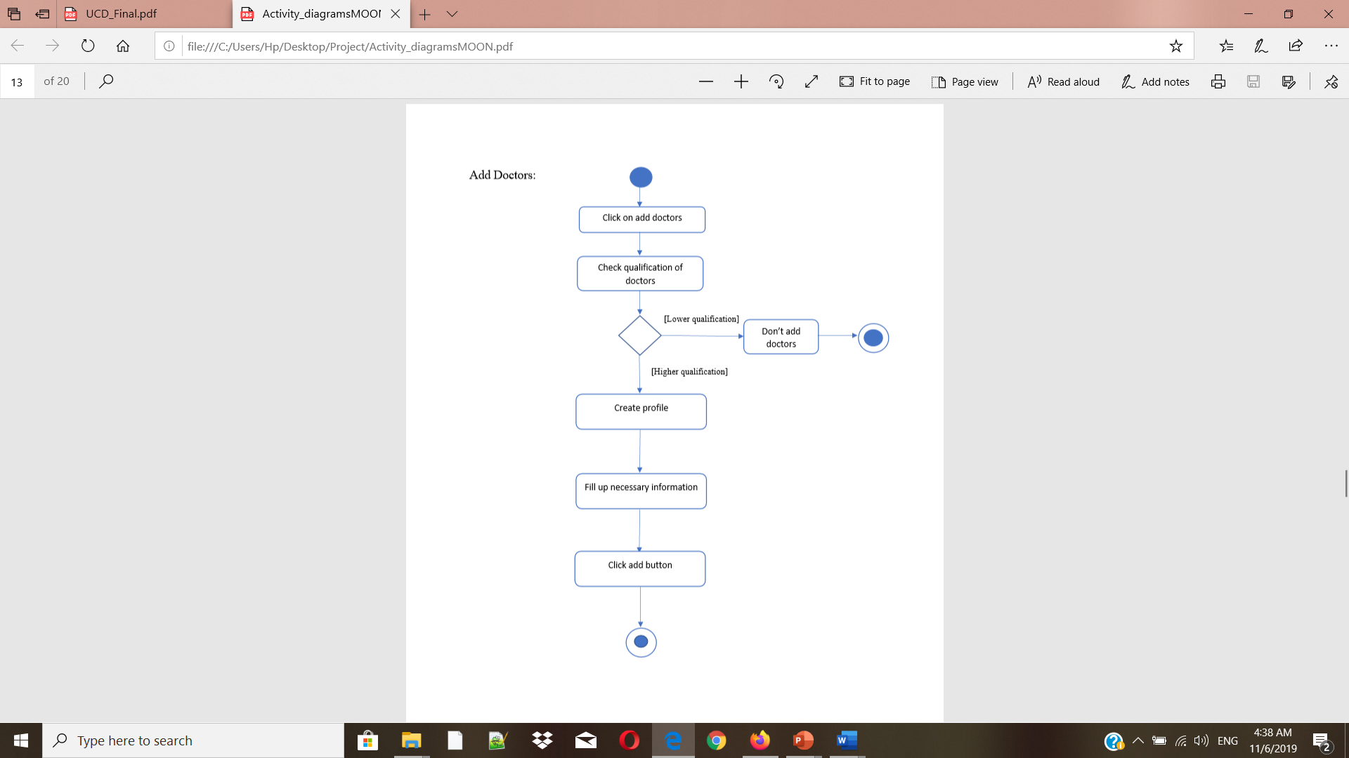
Use Case Description and Activity Diagram
WELCOME
To Our Project Presentation
Requirement Analysis
Requirements
Experience
Teams
history
Elicitation Techniques
history
history
history
follow
Mentor
services
teams
RTM
timeline
about
about
follow
about
services
teams
about
timeline
about
Introduction
about
about
Contents
about
about
Flappy Bird

Slide 21
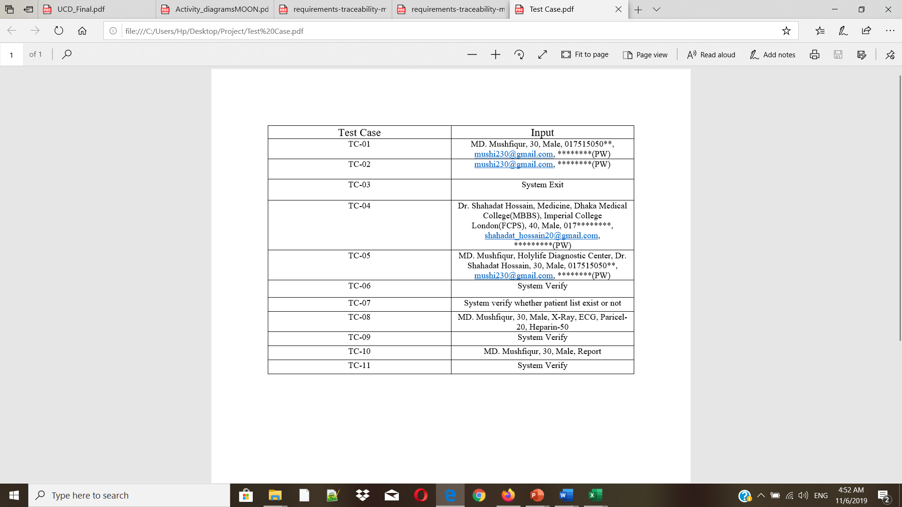
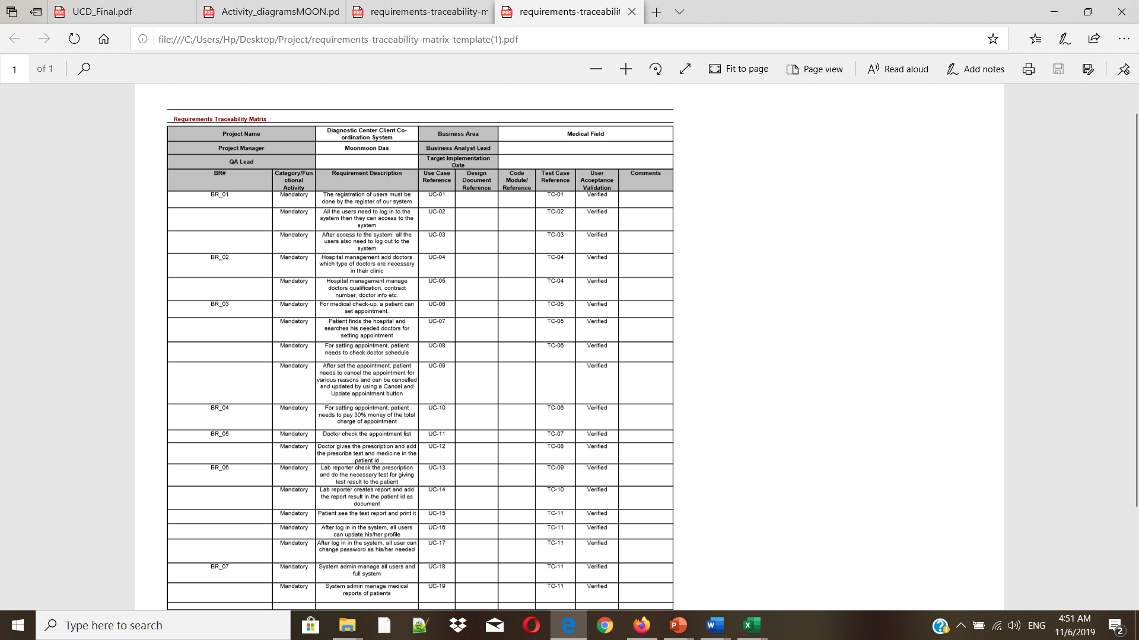
WELCOME
To Our Project Presentation
history
history
follow
history
services
teams
about
timeline
about
about
about
about
about
RTM
Flappy Bird

Slide 22
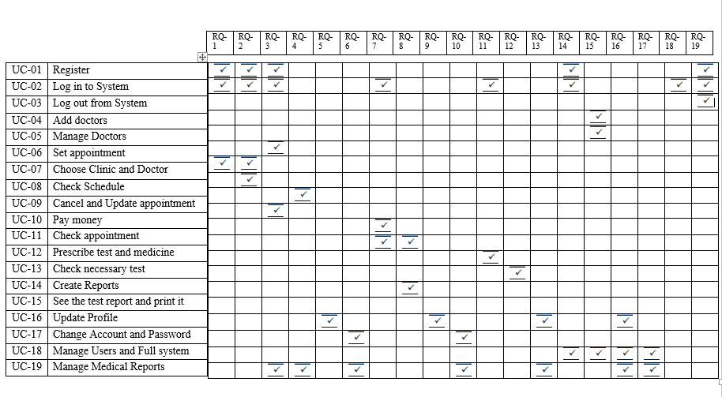
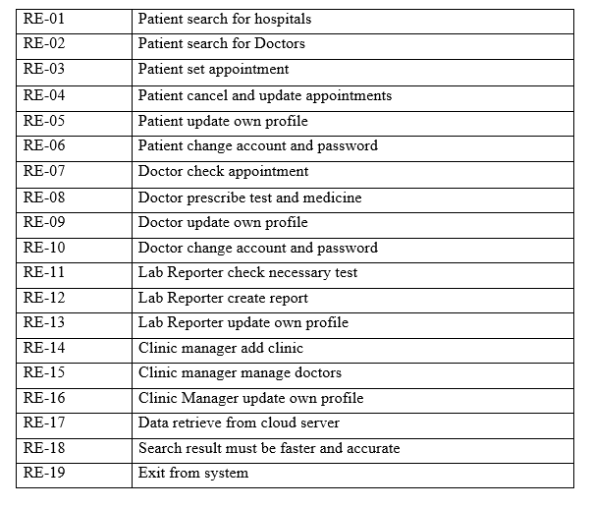
WELCOME
To Our Project Presentation
history
history
follow
history
services
teams
about
timeline
about
about
about
about
about
RTM
Flappy Bird

Slide 23




